Slide 1
General Tips for APA Reporting
Use readable spacing, placing a space after commas, variables and mathematical symbols. For example:
Correct: r(55) = .49, p < .001
Incorrect: r(55)=.49,p<.001.
APA suggests using two spaces after periods to aid readability, but this is not required.
If you use a table to report results, do not duplicate the information in the text.

Slide 2
General Tips for APA Reporting
In general, round decimals to two places, with the exception of p values. Values in the same paragraph or table should have the same number of decimal places.
If the decimal is less than one:
Place a zero before the decimal point if the statistic can be greater than one (0.26 lb).
If number cannot be greater than one, leave out the zero before the decimal point (p = .015).

Slide 3
General Tips for APA Reporting
Most symbols and abbreviations that are not Greek letters are italicized:
df, p, N, n, t, z, F, SD, SE, M.
Use an uppercase N for number in the population (N = 45) and a lowercase n for a sample (n = 20).

Slide 4
Reporting Results
The mean, standard deviation (and similar single statistics), degrees of freedom, and percentages should be reported within parentheses.
(M = 22, SD = 3.4)
t(10) = 2.16
“Almost a quarter of the sample (25.5%) was already infected with the virus.”

Slide 5
Reporting Results
For confidence intervals use brackets:
95% CI [2.47, 2.99]
If you are reporting a list of statistics within parentheses, you do not need to use brackets within the parentheses.
(SD = 1.5, CI = -5, 5)

Slide 6
Hypothesis Testing
At the beginning of the results section, restate your research question hypothesis and then state if your results support it. This should be followed by the data and statistics to support or reject the null hypothesis.
Nouns (z test, t test) are not hyphenated, but as an adjective they are (t-test results, z-test score).

Slide 7
Hypothesis Testing – p values
Use the alpha level (the a priori criterion for the probability of falsely rejecting your null hypothesis), which is typically .05 or .01.
F(1, 24) = 44.4, p < .01.
OR– Report the exact p value (the a posteriori probability that the result that you obtained, or one more extreme, occurred by chance). If you report exact p values, state early in the results section the alpha level used as a significance criterion for your tests.
“We used an alpha level of .05 for all statistical tests.”
t(33) = 2.10, p = .03.
If your exact p value is less than .001, it is conventional to state merely p < .001.

Slide 8
Hypothesis Testing
Report the sample statistics, followed by the test statistic and p value:
One sample: “Younger teens woke up earlier (M = 7:30, SD = .45) than teens in general, t(33) = 2.10, p = 0.03″
Two samples: “Younger teens indicated a significant preference for video games (M = 7.45, SD = 2.51) than books (M = 4.22, SD = 2.23), t(15) = 4.00, p < .001.”

Slide 9
Upcoming Methods: ANOVA
One-Way/Two-Way ANOVA: State the between-groups degrees of freedom, then state the within-groups degrees of freedom, followed by the F statistic and significance level.
“The main effect was significant, F(1, 149) = 2.12, p = .02.”

Slide 10
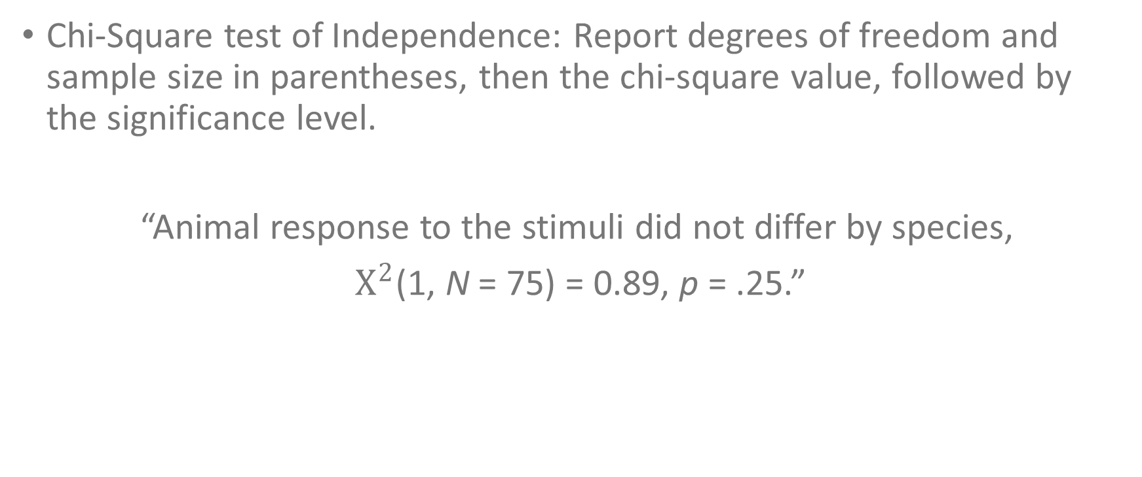
Upcoming Methods: Chi-Square test
Chi-Square test of Independence: Report degrees of freedom and sample size in parentheses, then the chi-square value, followed by the significance level.
“Animal response to the stimuli did not differ by species,
$Χ^{2}$(1, N = 75) = 0.89, p = .25.”

Slide 11
Upcoming Methods: Regression
Report correlations with degrees of freedom (N-2), followed by the significance level.
“The two sets of exam results are strongly correlated, r(55) = .49, p < .001.”

